Slide 1
Lecture 13: Trees

Slide 2
Trees vs trees
“Trees” are common
  You have likely heard about trees as the things growing outside
  You may have heard about decision trees
  You have probably not heard of the 2014 Slovenian film
  You have also likely heard about computer science trees as a data structure
    The trees that we will discuss today are related to, but quite distinct from, these trees

Slide 3
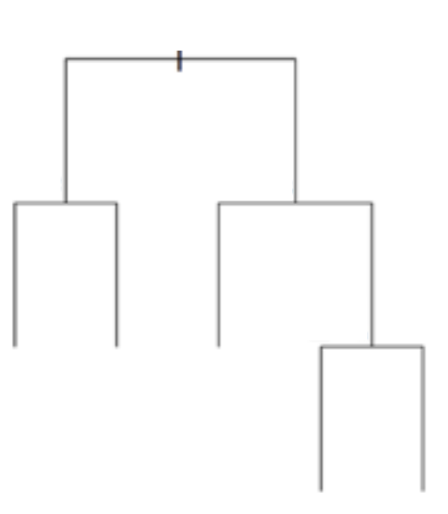
Machine learning trees
Represented in a similar way to how phylogenetic trees are represented in biology

Slide 4
Machine learning trees
Represented in a similar way to how phylogenetic trees are represented in biology
Built as binary trees
Data are stored at leaves with split points along axes
How do you split? Greedily
When do you stop? When points in leaves <= m

Slide 5
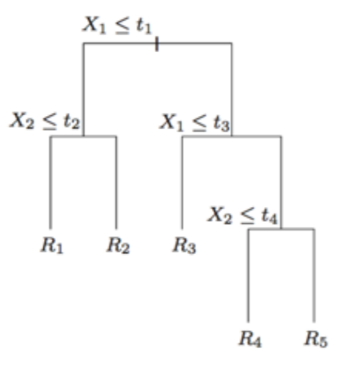
Learning decision trees
Start with an empty decision tree
Split on the next best feature/attribute
  That is, split on argmax_{i}(X_{i}) = argmax_{i}H(Y) – H(Y|X_{i})
Recurse
Prune

Slide 6
Trees
Have low bias, high variance
Deal quite well with categorical variables
Intuitive & easily understandable
Some theoretical guarantees (that we won’t go into)

Slide 7
Random forests
Tree methods have low bias but high variance
One way to reduce this variance is to generate a lot of related trees, assign weights to these trees, then average them
This is “bagging” or “bootstrap aggregating”

Slide 8
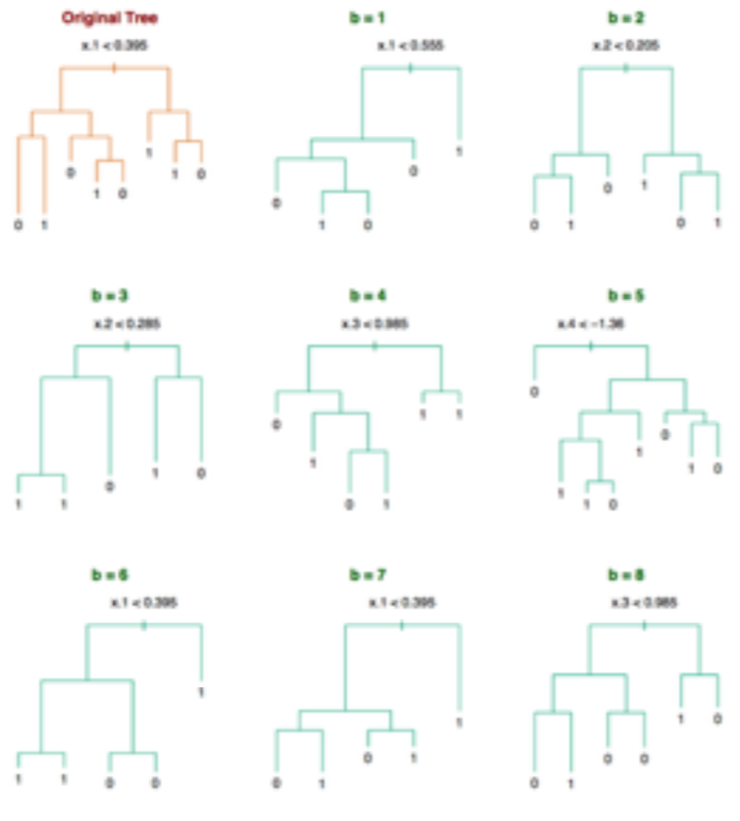
Random forests

Slide 9
Random forests
To grow a random forest, continue until you reach the desired number of nodes:
  Select m variables at random from among p variables
  Pick the best variable (split point) among the m
  Split the node into two daughter nodes
Output the ensemble of trees
This can be done for regression (mean tree) of classification (mode tree)

Slide 10
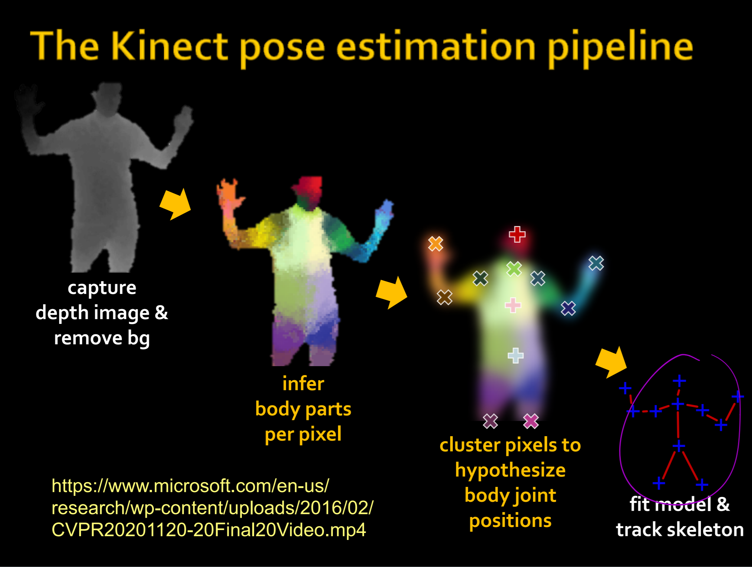

Slide 11
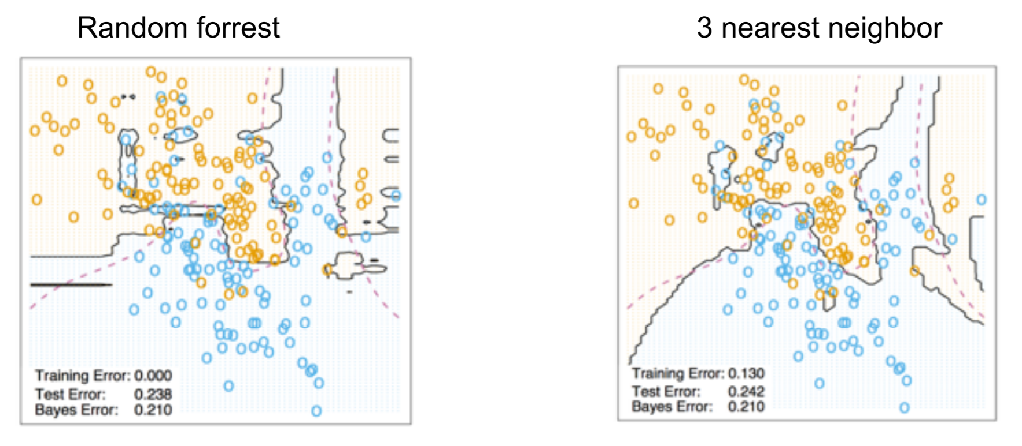
Random forest vs nearest neighbor

Slide 12
Random forests
Have low bias, low variance (corrects decision trees’ habit of overfitting)
Deal with categorical variables well
Not that intuitive or interpretable
Some theoretical guarantees
Can still overfit (although typically less likely than a single tree)

Slide 13
Ways to fix (or minimize) this: Bagging and Boosting next time

